Slide 1
Similarity in shapes
Task A: Identifying whether shapes are similar
1) Are the two shapes below similar? Justify your answer with reasoning.
116°
6 m
72°
135°
135°
4 m
127°
116°
72°
127°
8 m
3 m

Slide 2
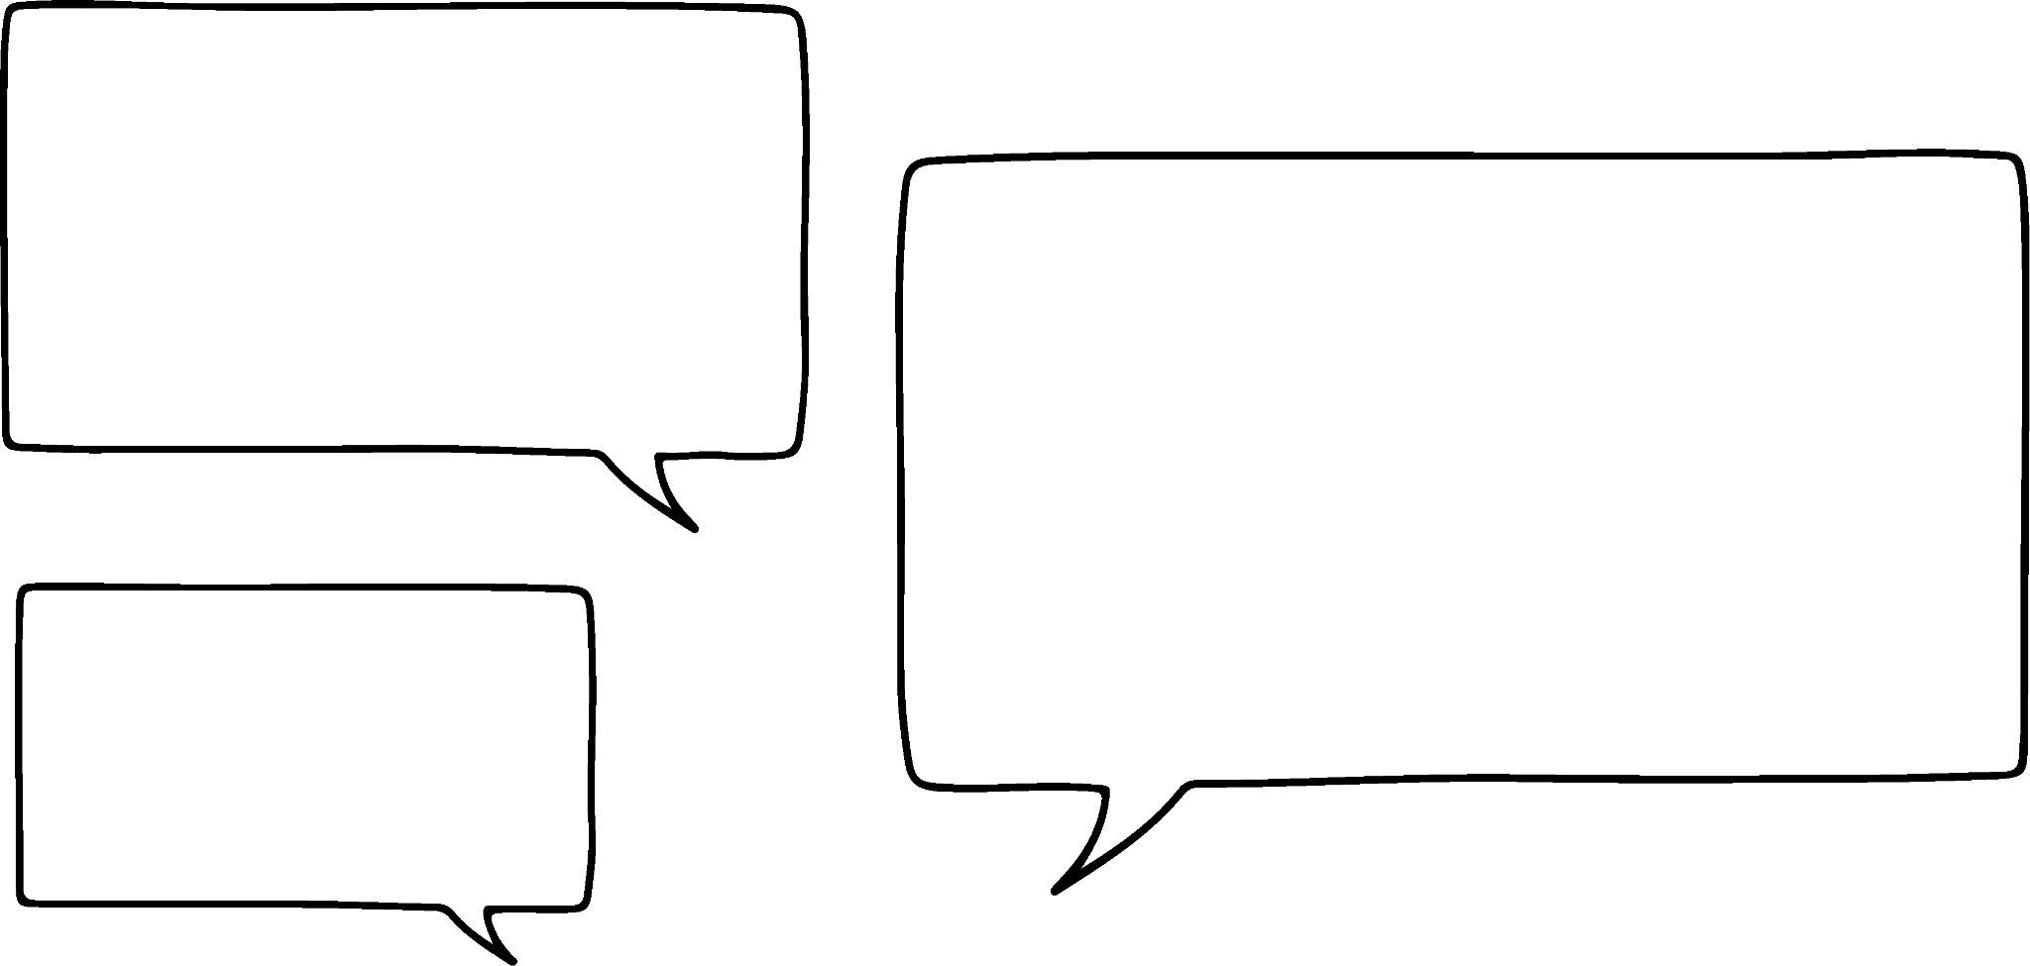




Similarity in shapes
2) Alex, Izzy, Jun and Sam have drawn some quadrilaterals.
This is my quadrilateral.
60°
120°
4 cm
Alex
120°
60°
6 cm
My quadrilateral is similar to Alex’s and all of the edges are twice the length.
Izzy
My quadrilateral is not similar to Alex’s, even though all the edges twice the length.
Jun
My quadrilateral is not similar to Alex’s, even all the angles are the same.
Sam
Sketch a possible quadrilateral for Izzy, Jun and Sam.
‹#›

Slide 3
Similarity in shapes
Task B: Finding similar shapes in complex diagrams
1) Find the value of each unknown.
4 cm
12 cm
5 cm
24 cm
a cm
b cm
12 cm
18 cm
c cm
60°
6 cm
12 cm
10 cm
15 cm
d cm
60°
5 cm
3 cm
30°
2) Take a piece of paper and fold it, as shown below.
The paper that does not overlap makes four triangles.
Prove that these four triangles are all similar.
Mathematics in Education and Industry
v2.3

